Slide 1
Best Practices
SE499: Software Design & Development Project

Slide 2
Define a clear and concise project scope statement
Clearly define the project's goals, deliverables, and timelines.
Identify stakeholders, their needs, and their roles in the project.
Establish a process for scope changes and ensure that all stakeholders are aware of it.

Slide 3
Example
Project Title: HealthyLife - A Mobile App for Healthy Living
Project Scope Statement:
The HealthyLife mobile app is designed to help users maintain a healthy lifestyle by tracking their diet, exercise, and providing well-calculated healthy recipes. The app will be developed for both Android and iOS platforms.

Slide 4
Example
Goals:
Develop a user-friendly and intuitive mobile app that allows users to track their daily calorie intake and burn.
Provide a database of healthy recipes with detailed nutritional information and step-by-step instructions.
Offer a meal planning feature that suggests healthy meals based on user preferences and dietary restrictions.
Incorporate a fitness tracker that records user exercise and provides personalized recommendations.
Enable users to set and track their health goals, such as weight loss or muscle gain.
Provide a social feature that allows users to share their progress and connect with like-minded individuals.

Slide 5
Example
Deliverables:
A fully functional mobile app for healthy meals, calories watch, fitness, and well-calculated healthy recipes.
A user manual and documentation for the app's features and functionality.
A presentation and demonstration of the app's key features.

Slide 6
Example
Stakeholders:
Project manager: responsible for overseeing the project's progress, ensuring timely delivery, and managing resources.
Software development team: responsible for designing, developing, and testing the app.
Quality assurance team: responsible for testing and debugging the app.
End-users: responsible for providing feedback and validation of the app's features and usability.
Project sponsor: responsible for providing funding and resources for the project.

Slide 7
Example
Process for scope changes:
Any scope changes must be approved by the project manager and documented in the project's change log.
The change log must include the reason for the change, the impact on the project's timeline and resources, and the new requirements or features.
The project manager will communicate any scope changes to the software development team, quality assurance team, and end-users.
The project manager will ensure that the project's goals and deliverables remain aligned with the scope changes.

Slide 8
Understanding the Real-World Impact
Our project addresses a critical issue in the [industry/field]
The problem we're solving affects [number] of people/businesses/organizations
Our solution has the potential to improve [aspect of society/environment/economy]

Slide 9
Understanding the Real-World Impact
Our project addresses a critical issue in the healthcare industry.
The problem we're solving affects # people who are diagnosed with diabetes every year.
Our solution has the potential to improve the quality of life for people living with diabetes by providing them with a more efficient and personalized way to manage their condition.
By streamlining the process of tracking and managing diabetes, our solution can help reduce the economic burden of the disease on the healthcare system.

Slide 10
Connecting Our Project to Real-World Challenges
"Our project addresses a specific challenge in the [industry/field]
This challenge is a major concern for [stakeholders/businesses/organizations]
Our solution could potentially disrupt/improve the way [industry/field] operates
Our project aligns with the goals of [related initiatives/policies/regulations]

Slide 11
Potential Impact
Our solution has the potential to [positive impact on society/environment/economy]
This impact could be felt by [number] of people/businesses/organizations
Our project could contribute to [larger social/environmental/economic goal]
The potential benefits of our project are [specific benefits, e.g. cost savings, increased efficiency, improved health outcomes]

Slide 12
What Sets Our Project Apart
"Our project is unique because it [briefly describe the project's unique features or approach]
This approach/feature set us apart from other projects in the industry
Our project's uniqueness provides a competitive advantage in the market

Slide 13
The Value We Bring
Our project offers [describe the specific benefits or value that the project provides]
These benefits/value are not currently available in the market
Our project's added value sets us apart from the competition

Slide 14
Our Competitive Edge
Our project's unique approach/features give us a competitive advantage in the market
Our project offers [describe the specific benefits or value that the project provides]
This sets us apart from the competition and provides a strong selling point

Slide 15
Capitalizing on a Growing Market
The market for [specific industry/service] is growing rapidly
Our project is well-positioned to capitalize on this growth
Our unique approach/features make us an attractive option for customers

Slide 16
Use design patterns and principles
Use design patterns to solve common software design problems.
Design Patterns: A Solution to Common Software Design Problems
Examples of design patterns (e.g. Singleton, Factory, Observer)
Benefits of using design patterns (e.g. improves code maintainability, scalability, and extensibility)

Slide 17
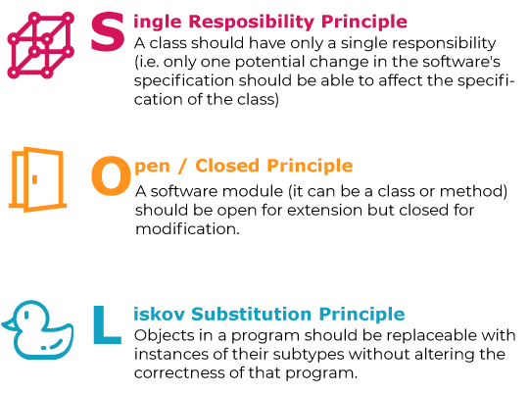
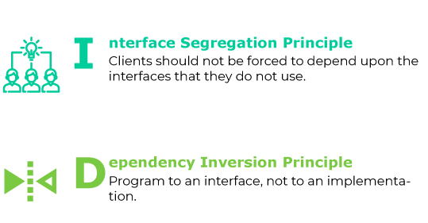
SOLID Principles
Apply principles such as SOLID (Single Responsibility, Open/Closed, Liskov Substitution, Interface Segregation, and Dependency Inversion) to ensure that code is maintainable, scalable, and extensible.

Slide 18
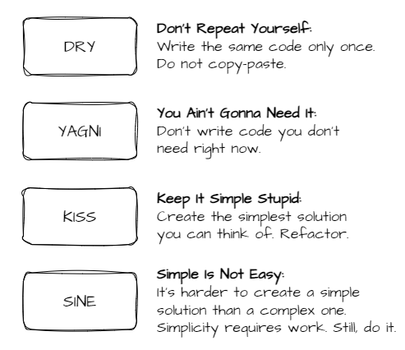
DRY (Don't Repeat Yourself)
DRY is a principle that emphasizes the importance of avoiding duplication in software systems.
It encourages developers to create reusable code and to avoid repeating the same code or functionality in multiple places.
Duplication can lead to maintenance nightmares, bugs, and inconsistencies.

Slide 19
DRY (Don't Repeat Yourself)
DRY can be applied in various ways, such as:
Functional programming: Write functions that perform a single task and can be reused in different parts of the codebase.
Modular design: Break down the codebase into smaller, independent modules that can be reused and combined in different ways.
Object-oriented programming: Use inheritance and polymorphism to create reusable classes and objects.
Utility classes: Create classes or modules that provide a set of related functions or utilities that can be used across the codebase.

Slide 20
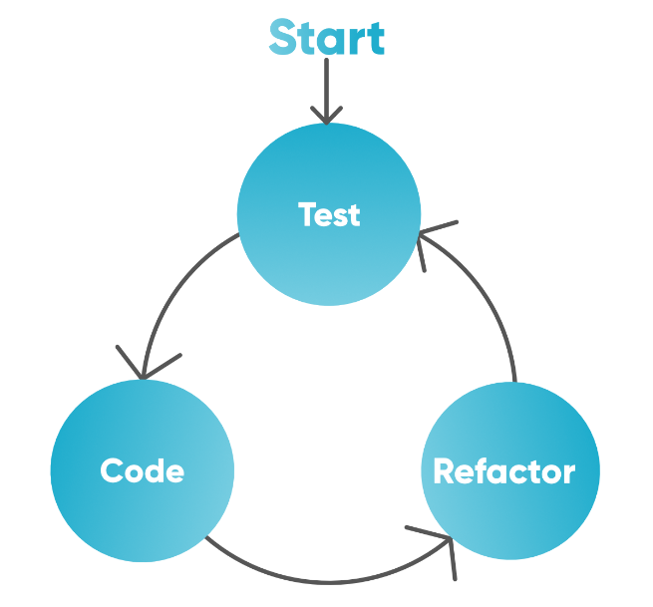
Write clean, modular, and maintainable code
Use modular design to break down code into smaller, independent components.
Write clean, readable, and maintainable code that adheres to coding standards and best practices.
Use version control systems to track changes and collaborate with team members.

Slide 21
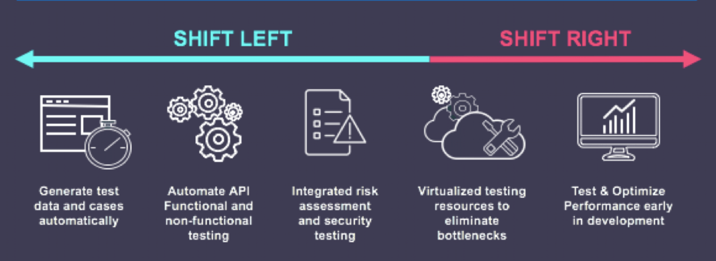
Test early and often
Develop a comprehensive testing strategy that includes unit, integration, system, and acceptance testing.
Use automated testing tools to ensure that tests are run repeatedly and consistently.
Use testing frameworks to write and run tests efficiently.

Slide 22
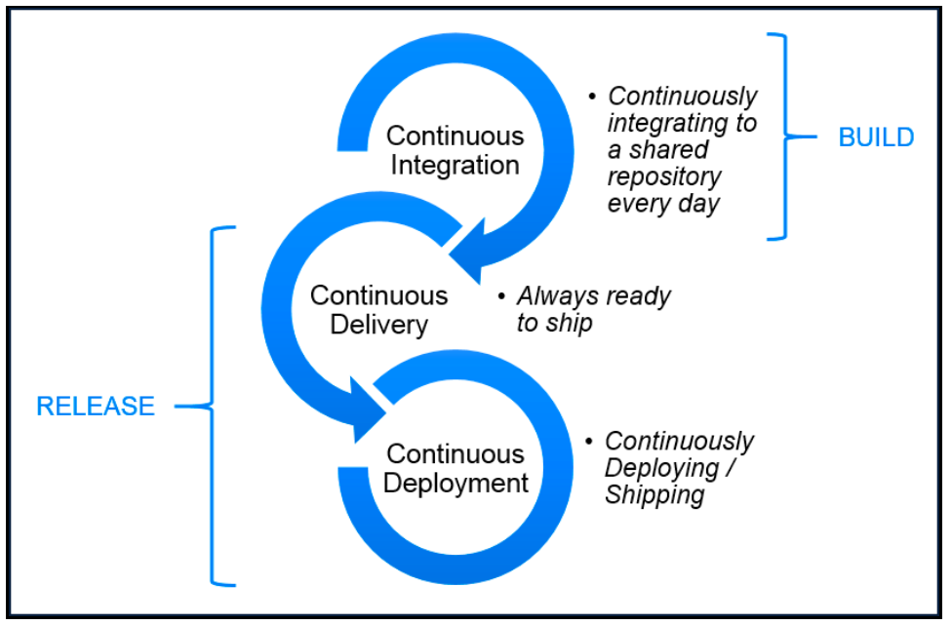
Use continuous integration and delivery
Use a CI/CD pipeline to automate the build, test, and deployment process.
Ensure that code changes are automatically built, tested, and deployed to production.
Use continuous monitoring and feedback to improve the quality and reliability of the software.

Slide 23
Document the project
Create comprehensive documentation that includes project scope, requirements, design, testing, and deployment.
Ensure that documentation is up-to-date and accessible to all stakeholders

Slide 24
The Importance of Documentation
Why documentation matters and how it can help your project succeed
Ensures that all stakeholders are on the same page
Provides a reference for future development and maintenance
Helps to identify and mitigate risks
Supports communication and collaboration among team members
Facilitates knowledge transfer and training

Slide 25
Best Practices for Documentation
Use simple language and avoid technical jargon
Organize documentation into clear and logical sections
Use headings, subheadings, and bullet points to make information easy to scan
Include examples and diagrams to illustrate complex concepts
Use active voice and avoid passive voice
Keep documentation up-to-date and review regularly
Use version control to track changes and collaborate with team members

Slide 26
Documentation
Documentation is an essential part of software development projects
Clear, concise, and comprehensive documentation helps to ensure project success
Following best practices for documentation can improve communication, collaboration, and productivity
Investing time and effort in documentation pays off in the long run
Remember, documentation is not just a requirement, it's an opportunity to create a better project.

Slide 27
Use security best practices
Use security best practices such as secure coding practices, secure communication protocols, and secure data storage.
Ensure that all sensitive data is encrypted and access is restricted to authorized personnel.

Slide 28
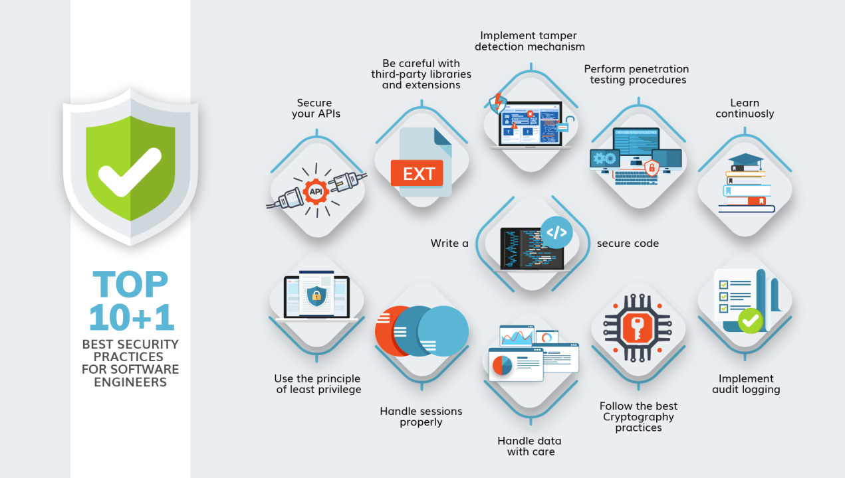

Slide 29
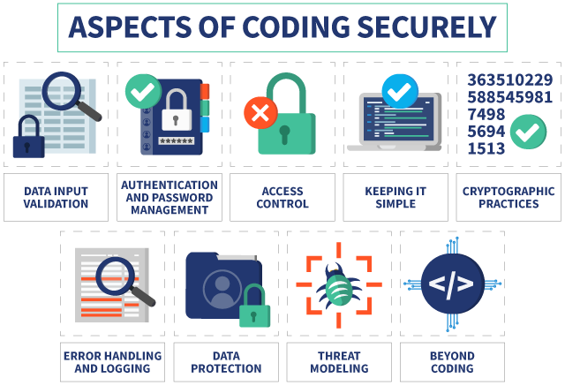
Coding Securely

